Slide 1
Timbre as envelope
One-person a cappella live Daniel, 6/28/2021

Slide 2
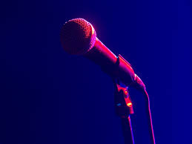
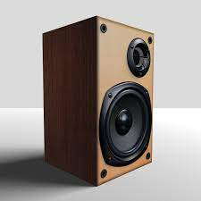
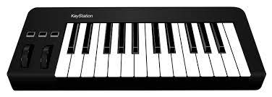
Goal
Timbre from voice + pitches from midi keyboard.
Compared to singing: polyphonic.
Compared to playing the piano: timbre control + expression control + lyrics
Timbre
Pitch

Slide 3
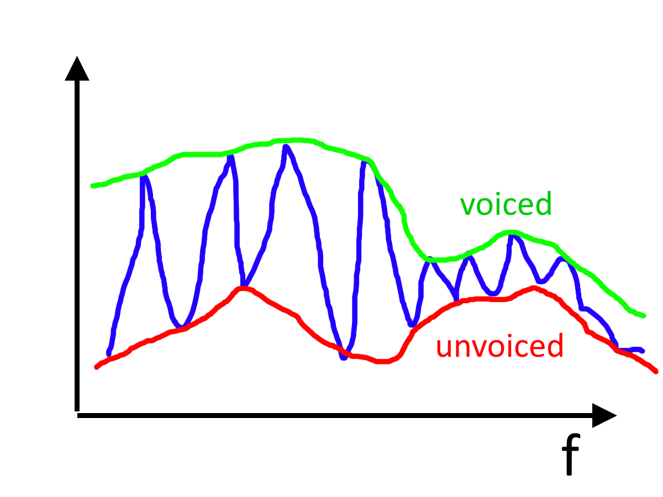
Overview

Slide 4
Related
Vocoder
Encoder for voice. Useful for compression.

Slide 5
One natural way to disentangle
Pitch |  |  | Shift
Loudness |  |  | Keep
Timbre | 瞬时 | 唱腔 | Keep
 |  | Who I am | Keep
 | temporal
 |  | lyrics | Keep
Notes:
注意 loudness 和 timbre 的 disentanglement. 可以一样的 timbre 不一样响，vice versa.
瞬时：harmonics
Temporal: ADSR of volume; ADSR of 瞬时 timbre…

Slide 6
Why not ML?
Speech style transfer has witnessed tremendous progress in ML.
Today let’s use rule-based.

Slide 7
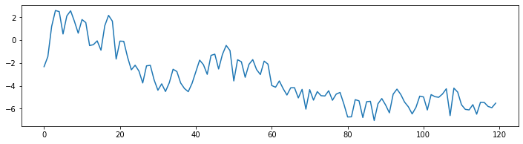

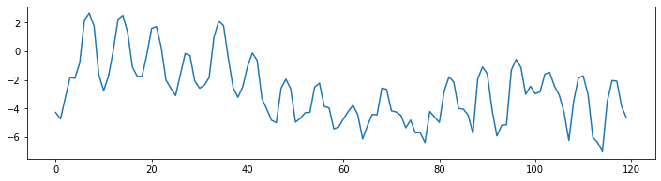
Naïve technique: pitch shift via resampling
Notes:
保留了什么 没保留什么

Slide 8
Eyeball time
[Zoom share phone screen]

Slide 9
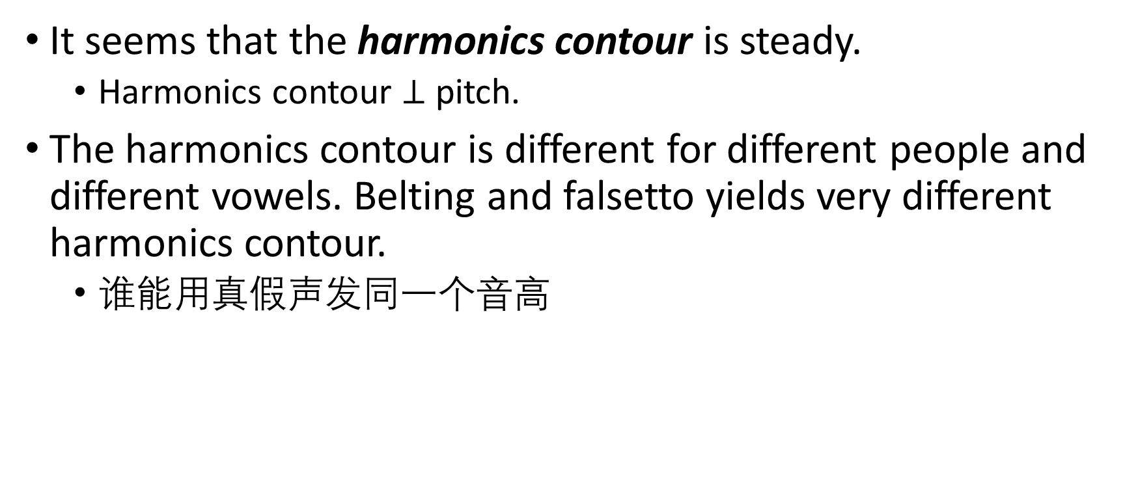
Eyeball time
It seems that the harmonics contour is steady.
Harmonics contour $⊥$ pitch.
The harmonics contour is different for different people and different vowels. Belting and falsetto yields very different harmonics contour.
谁能用真假声发同一个音高

Slide 10
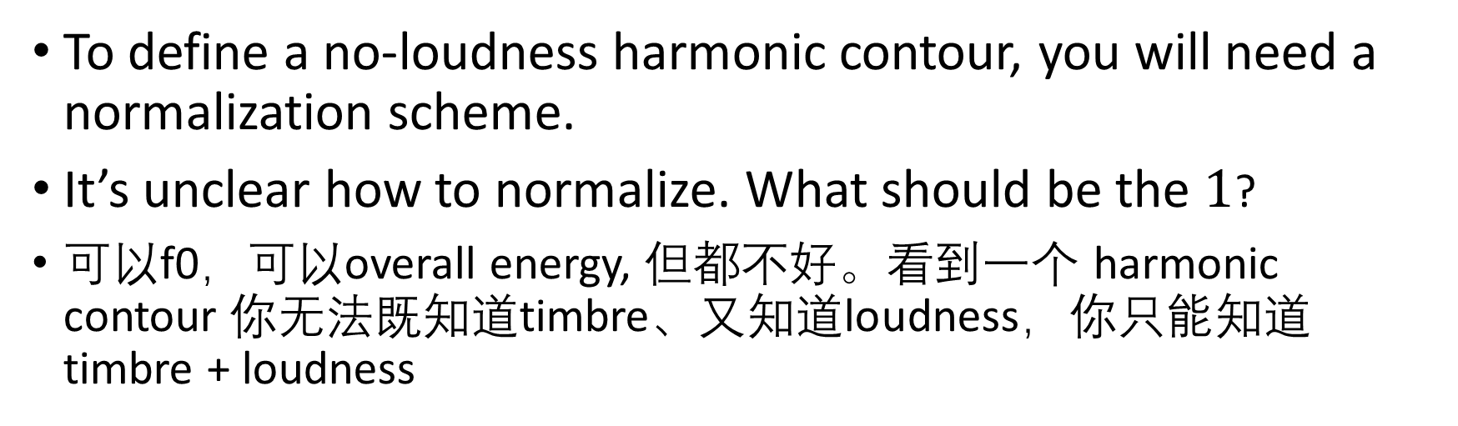

Harmonic contour $∋$ loudness
To define a no-loudness harmonic contour, you will need a normalization scheme.
It’s unclear how to normalize. What should be the $1$?
可以f0，可以overall energy, 但都不好。看到一个 harmonic contour 你无法既知道timbre、又知道loudness，你只能知道timbre + loudness

Slide 11
Harmonic contour $∋$ loudness
Therefore, to synthesize, multiply a pulse train with the harmonic contour!
Pulse train generated from midi keyboard input.
“Multiplicative synthesis”?
“偷梁换柱”

Slide 12
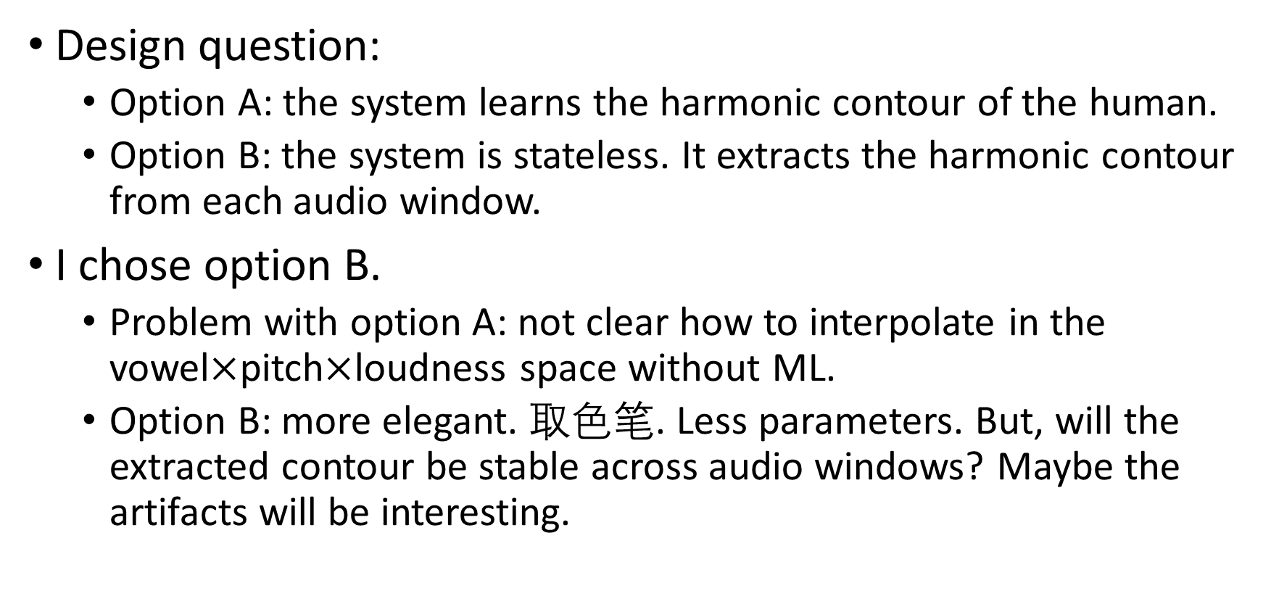
Persistent state?
Design question:
Option A: the system learns the harmonic contour of the human.
Option B: the system is stateless. It extracts the harmonic contour from each audio window.
I chose option B.
Problem with option A: not clear how to interpolate in the vowel$×$pitch$×$loudness space without ML.
Option B: more elegant. 取色笔. Less parameters. But, will the extracted contour be stable across audio windows? Maybe the artifacts will be interesting.

Slide 13
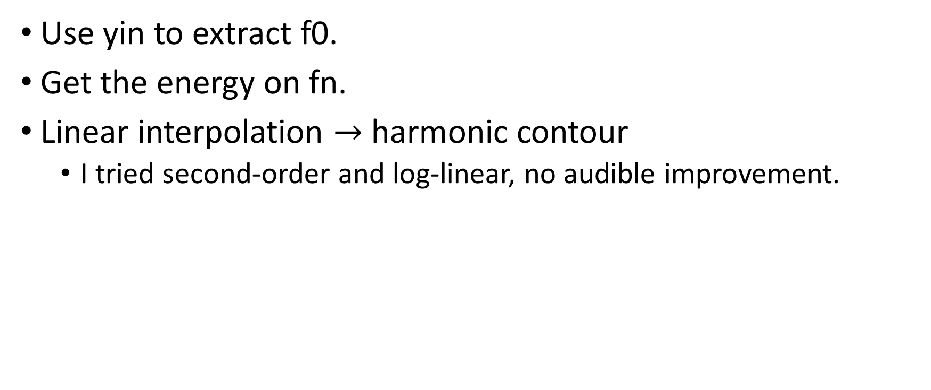
How to extract the harmonic contour
Use yin to extract f0.
Get the energy on fn.
Linear interpolation $→$ harmonic contour
I tried second-order and log-linear, no audible improvement.

Slide 14
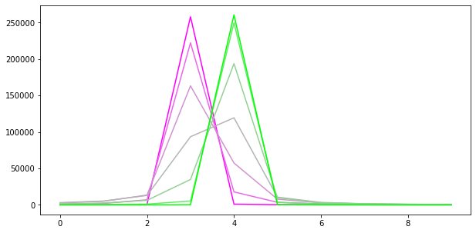
How to get the energy on fn?
Naïve: use the energy in the fft frequency bin containing fn.
This is inaccurate due to spectral leakage and off-centered binning.
Eyeballing easily shows that the inaccuracy is unacceptable.
Solution 1: SFT (slow Fourier transform)
Solution 2: Hann, fft, then use the sum of the squared energy of nearby frequency bins.
I used three bins under SR = 22050, PAGE_LEN = 768.

Slide 15
Benchmark
Original |  | reconstruct | +2 | +5 | +7 | +12
 | resample | NA
 | ours

Slide 16
The unvoiced component
Thanks to Ninghu’s concise lit review
Speech = voiced + unvoiced
Voiced: has f0 and harmonics
Unvoiced: unpitched
Previously, each audio page was classified into either voiced or unvoiced. Now, better algos view each page as a sum of two components.

Slide 17
Eyeball time Encore
[Zoom share phone screen]

Slide 18
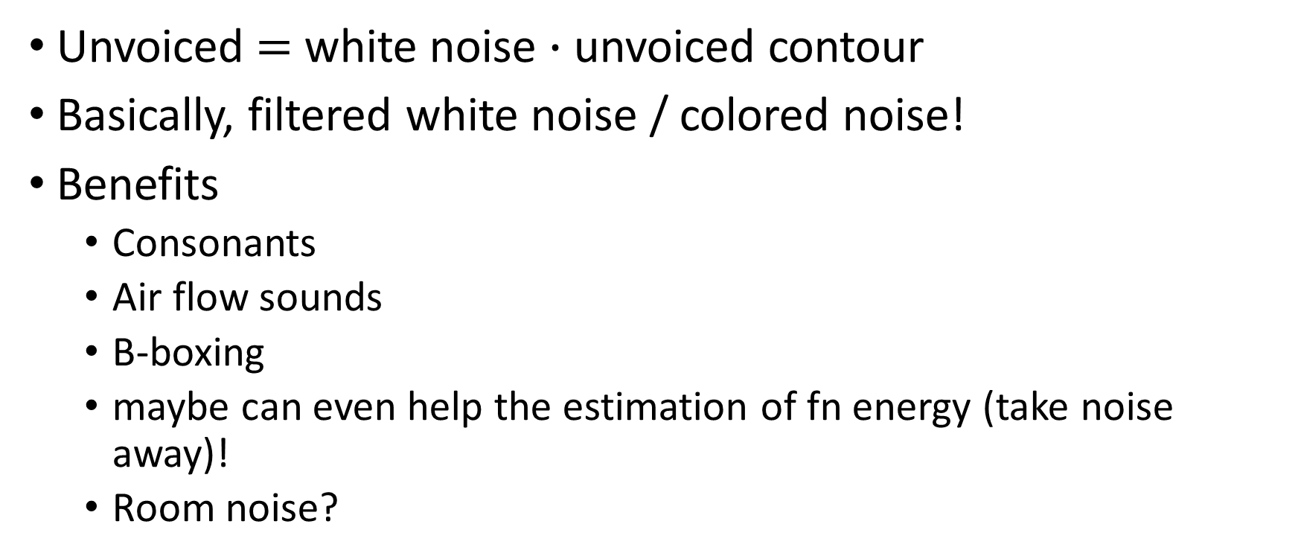
Unvoiced component model
Unvoiced $=$ white noise $∙$ unvoiced contour
Basically, filtered white noise / colored noise!
Benefits
Consonants
Air flow sounds
B-boxing
maybe can even help the estimation of fn energy (take noise away)!
Room noise?

Slide 19
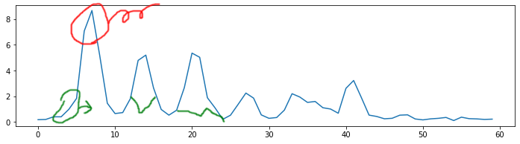
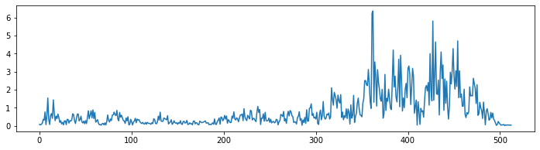
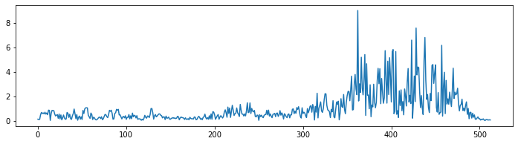
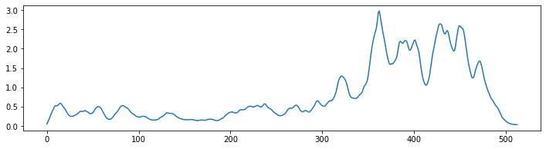
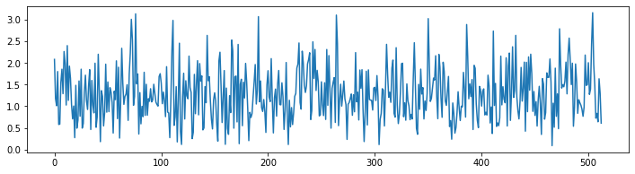
Original spectrum
Remove harmonics
Original unvoiced
Synthesized
Low pass
Unvoiced contour
Complex white noise, freq domain

Slide 20
How to synthesize the unvoiced?
Extract the unvoiced contour.
Remove all bins near fn’s. Replace them with neighboring bins.
Low-pass.
Make some noise.
In the frequency domain, sample gaussian-distributed complex numbers array.
Eyeballing experiments results: Must not be uniform distribution. Must not be in log scale.
Apply filter / contour.
ifft.

Slide 21
Misc.
Why not just take the original spectrum with harmonics removed?
That will leave some pitched component in the audio.
Interpolate magnitude to avoid across-page clacks.
Previously I thought as long as it’s noise there wouldn’t be any clacks. I was wrong.

Slide 22
Benchmarking
Original
Extracted voiced
Extracted unvoiced
Reconstruction
Notes:
Assumption: Monophonic! 0-phonic is polyphonic!

Slide 23
Recap
Pitch |  |  | Shift
Timbre | 瞬时 | Voiced | Keep
 |  | Unvoiced | Keep
Notes:
注意 loudness 和 timbre 的 disentanglement. 可以一样的 timbre 不一样响，vice versa.
瞬时：harmonics
Temporal: ADSR of volume; ADSR of 瞬时 timbre…

Slide 24
HybridSynth
写了一个包 HarmonicSynth. Additive synth with oscillators.
Pros: keeps phase across audio pages; accurate freq; freq and mag interpolation between pages (to avoid clacks).
写了一个包 IfftSynth
Pro: fast
写了一个包 HybridSynth = HarmonicSynth + IfftSynth
Low-freq components: additive synth. High-freq components: ifft.
This balances computation costs and frequency accuracy.
Am I missing something? Any easier way?

Slide 25
Fun
Pitch multiplier: 1, 0, 0.5, 2, -1
A quick brown fox jumps over the lazy dog
蜀道之难 难于上青天
无论发生什么事，今天谁也别想走
Notes:
我：不会说上海话。x2：像了

Slide 26
Piano https://freesound.org/people/leewarner/sounds/367533/
Original
Extracted voiced
Extracted unvoiced
Reconstruction
Notes:
Original 能听出按键声吗？

Slide 27
Piano chords https://freesound.org/people/Lemoncreme/sounds/186942/
Original
Extracted voiced
Extracted unvoiced
Reconstruction

Slide 28
Violin https://freesound.org/people/FreqMan/sounds/42954/
Original
Extracted voiced
Extracted unvoiced
Reconstruction
Notes:
Original 能听出拉弓声吗？

Slide 29
Electric Violin https://freesound.org/people/owstu/sounds/508530/
Original
Extracted voiced
Extracted unvoiced
Reconstruction

Slide 30
Flute https://freesound.org/people/womb_affliction/sounds/376532/
Original
Extracted voiced
Extracted unvoiced
(Reconstruction)
Notes:
Tremolo VS reverb: which one will break it?
Why is the reverb not captured in unvoiced? Low-pass, they too sharp.

Slide 31
Drum https://freesound.org/people/Kevcio/sounds/263869/
Original
Extracted voiced
Extracted unvoiced
(Reconstruction)

Slide 32
Trumpet https://freesound.org/people/sorohanro/sounds/77708/
Original
Extracted voiced
Extracted unvoiced
Reconstruction

